Slide 1
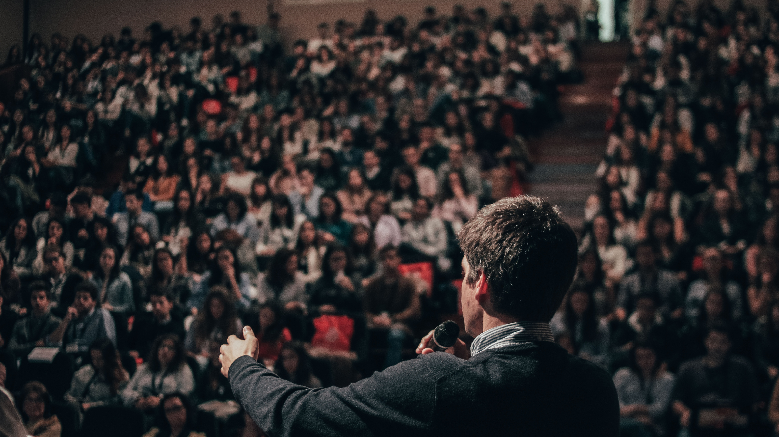

TED Talks Videos Analysis
Group E Manunpat Sirijaturaporn, Jiaming Huang, Ting Yang

Slide 2
Research Questions
Speakers’ sentiments analysis for each videos
Sentiments v.s. Topics
Sentiments v.s. Likes
Sentiments over time
Text classicification for predicting videos’ topics

Slide 3
Steps Applied
Data Acquisition
Tokenization
EDA
Sentiment Analysis
Topic Modelling
Embedding
Supervised Analysis

Slide 4
Data Acquisition

Slide 5
Wrangling and cleaning
Outcome
TED
TED_full
posted | cate | like | view | subcate | text | transcript
2021-03-01 | 1 | 1500 | 513440 | 1.1 | 1.1.1 | Today, artificial intelligence helps doctors diagnose patients,…
2021-03-01 | 1 | 1500 | 513440 | 1.1 | 1.1.2 | As the treatments progress and the program receives more…
2019-10-01 | 1 | 9500 | 3170321 | 1.2 | 1.2.1 | So, artificial intelligence is known for disrupting all kinds of i…
… | … | … | … | … | … | …
2021-01-01 | 3 | 17000 | 593714 | 3.97 | 3.97.1 | You know how your partner likes their coffee, what love lan…
AI represents by 1
Climate change represents by 2
Relationships represents by 3
Notes:
Im not sure which way to present AI = 1, Climate change =2, Relationships =3. Could it work well with table? Or keep text?. Help me please

Slide 6
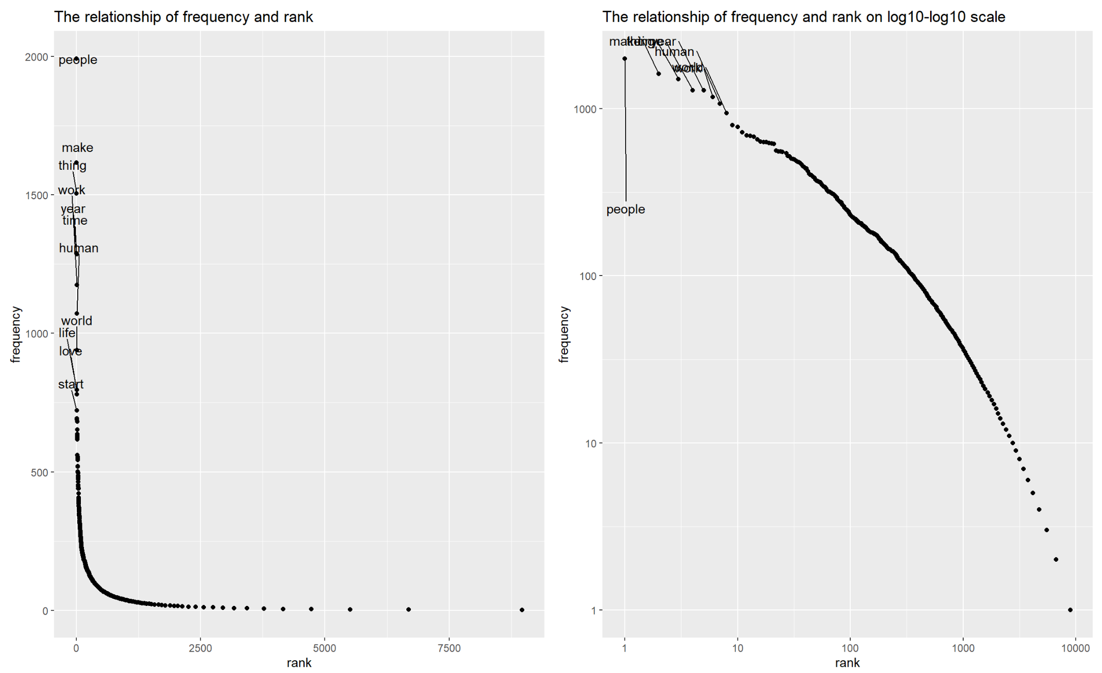
TOKENIZATION
Quanteda
Zipf’s law
OUTCOME
Document-Term Matrix
TFIDF matrix

Slide 7
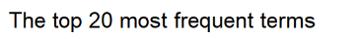
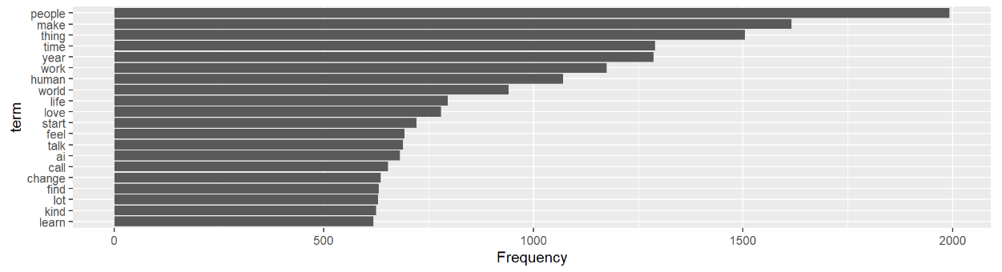
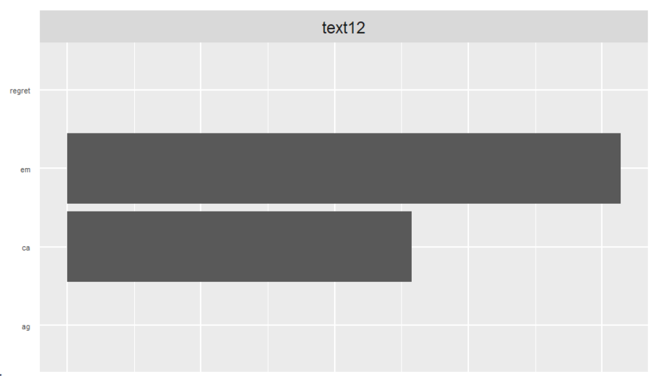
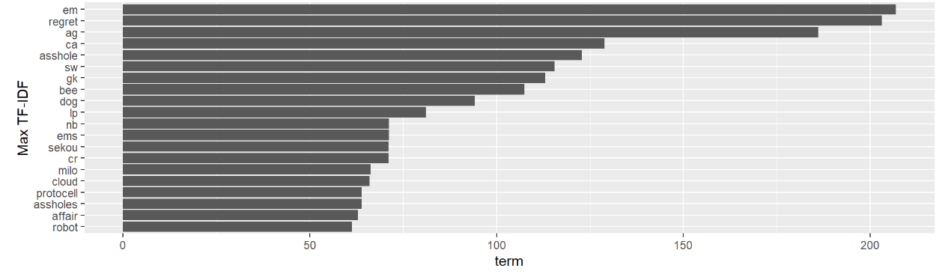
Exploratory Data Analysis
Notes:
Can you add animation for text12 picture and make a red block for em and ca?

Slide 8
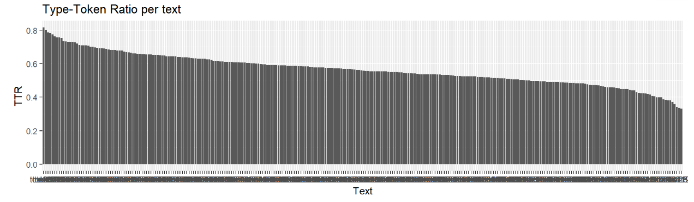
Exploratory Data Analysis
Notes:
Can you add animation for text12 picture and make a red block for em and ca?

Slide 9
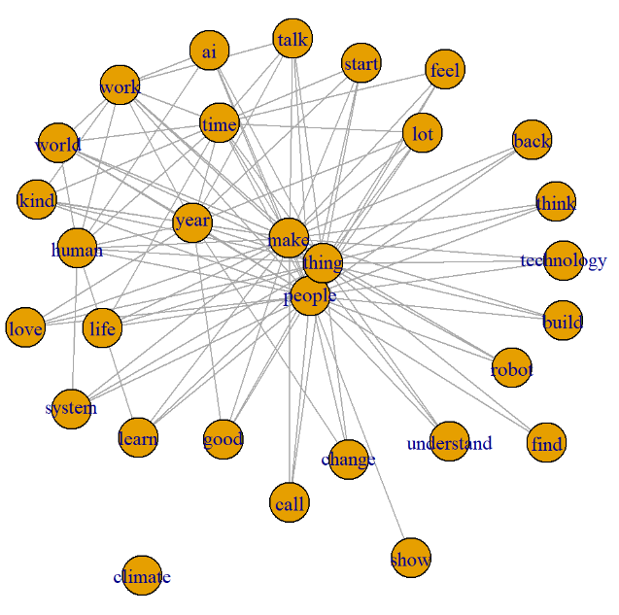
Exploratory Data Analysis
Notes:
Can you add animation for text12 picture and make a red block for em and ca?

Slide 10
Sentiment analysis

Slide 11
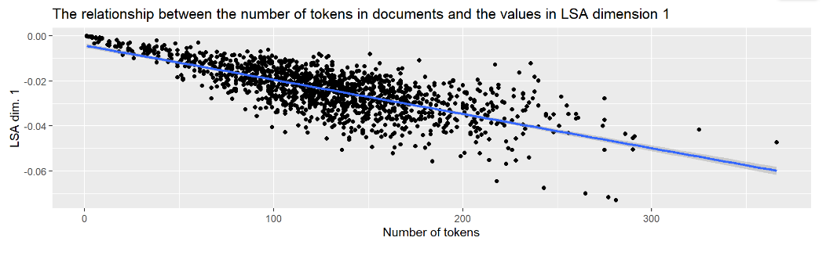
Topic Modelling
LSA(TF)

Slide 12
Topic Modelling
LSA(TF)
Dimension2 top word
Dimension3 top word
Dimension4 top word

Slide 13
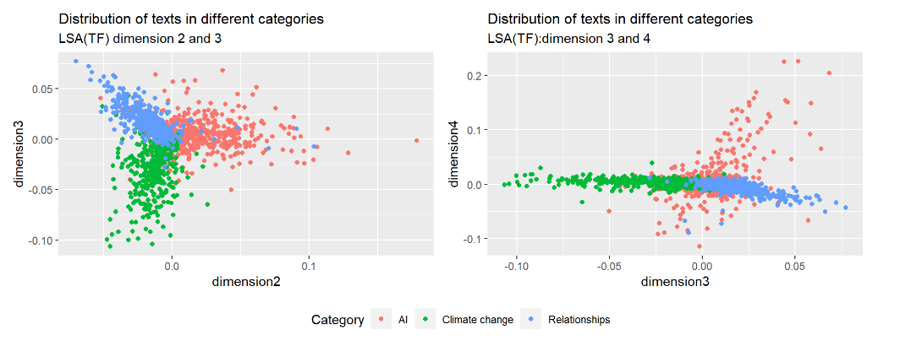
Topic Modelling
LSA(TF)

Slide 14
Topic Modelling
LSA(TF-IDF)
Dimension2 top word
Dimension3 top word
Dimension4 top word

Slide 15
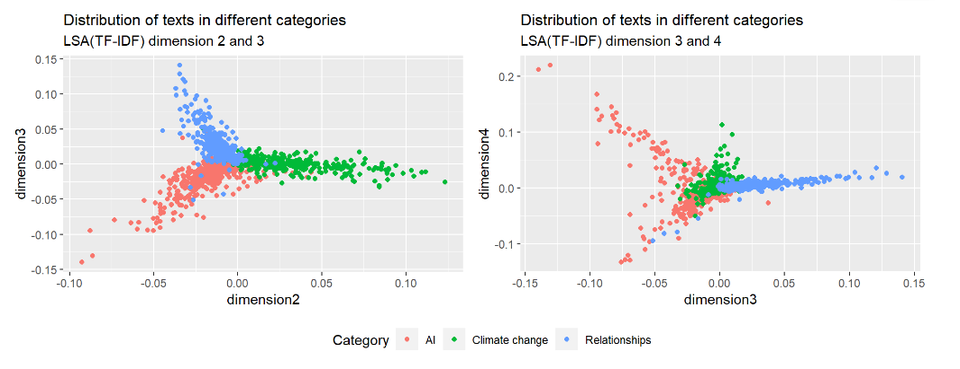
Topic Modelling
LSA(TF-IDF)

Slide 16
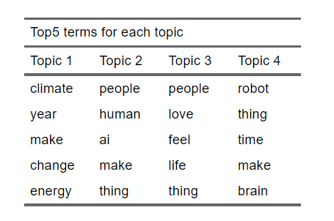
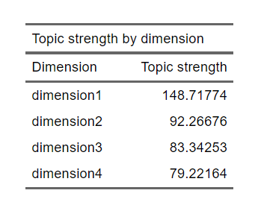
Topic Modelling
LDA

Slide 17
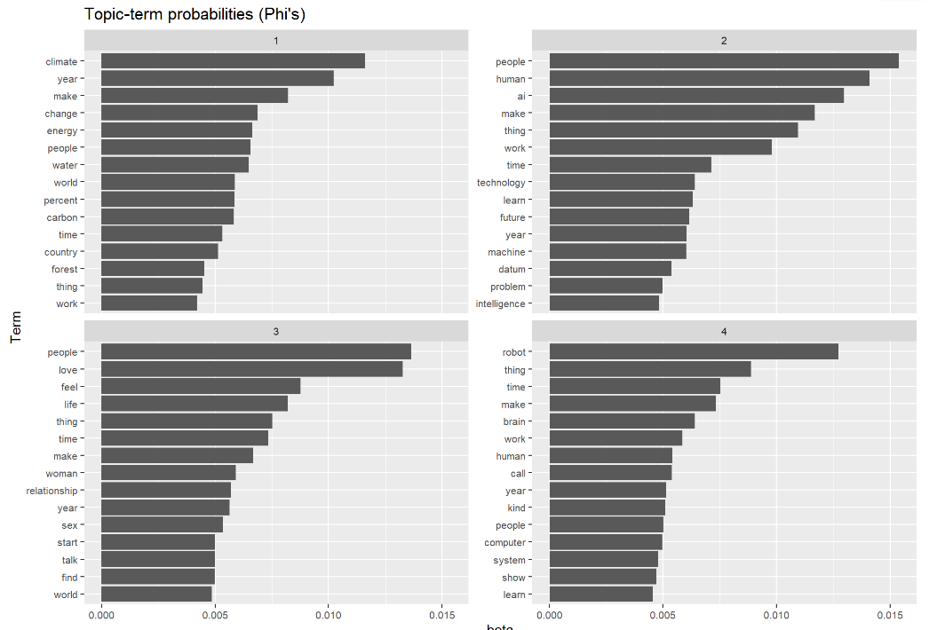
Topic Modelling
LDA

Slide 18
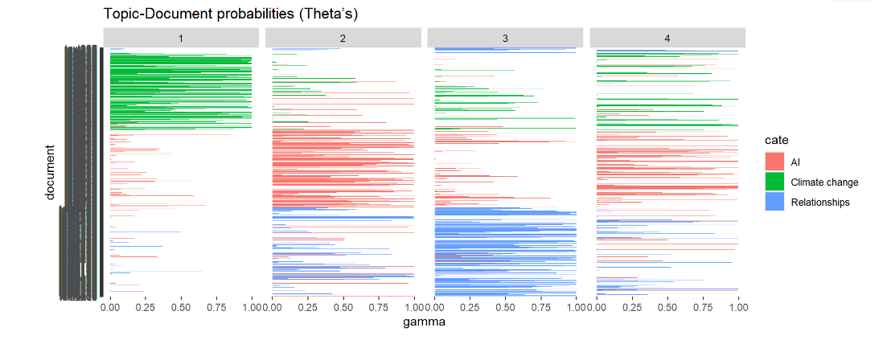
Topic Modelling
LDA

Slide 19
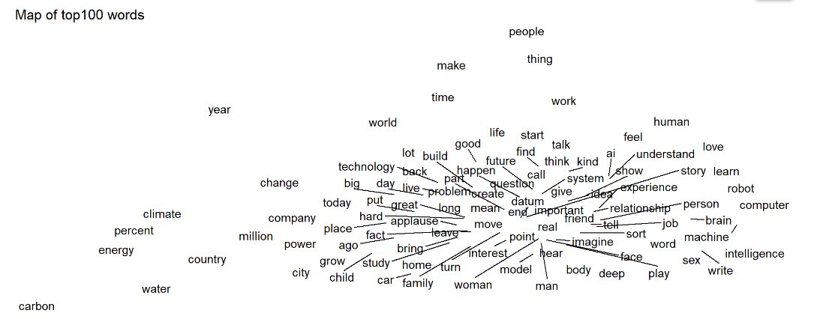
Embedding
Word embedding

Slide 20
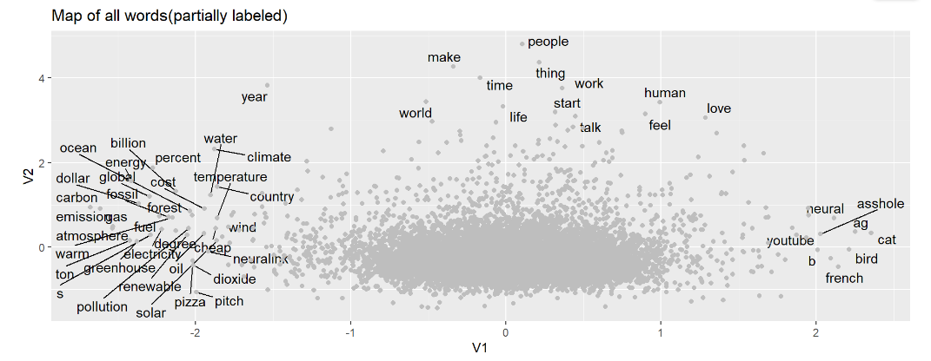
Embedding
Word embedding

Slide 21
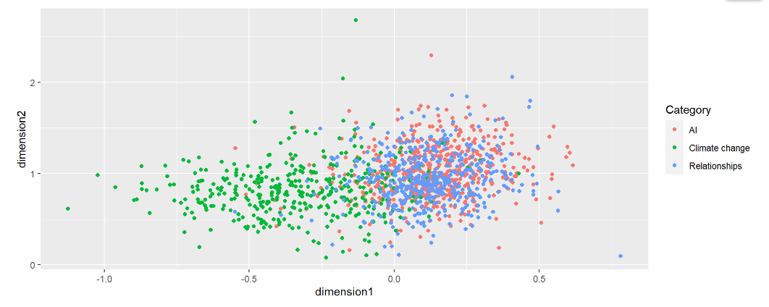
Embedding
Document embedding

Slide 22
Supervised Analysis
Model | Accuracy | Balanced Accuracy on Topic 1 | Balanced Accuracy on Topic 2 | Balanced Accuracy on Topic 3 | Kappa
LSA on TF | 0.8089 | 0.8340 | 0.8911 | 0.8576 | 0.7131
LSA on TF-IDF | 0.8805 | 0.8897 | 0.9317 | 0.9156 | 0.8198
Embedding | 0.6143 | 0.6540 | 0.8788 | 0.6225 | 0.42
LSA(TF-IDF), like and views | 0.9044 | 0.9131 | 0.9465 | 0.9310 | 0.8559

Slide 23
Conclusion
sentiment analysis:
TED talks tend to present a positive sentiment
the results of sentiment analysis may not differentiate between different categories of documents or texts.
Topic modeling:
the clusters generated by both Latent Semantic Analysis (LSA) and Latent Dirichlet Allocation (LDA) were closely aligned with the categories labeled by the TED website
Supervised learning:
The model which combines LSA on TF-IDF and additional information such as the number of likes and views has the highest accuracy.

Slide 24
Limitations and Further study
Limitation:
difficult to obtain a large amount of transcript data due to limitations in time and computer capacity.
the structure of the TED website is not conducive to scraping text.
the distribution of additional features on the TED website is fragmented.
Further study:
expand our research based on the available information.
We can also analyze the variations in the wording of speeches given by the same speakers or on the same topics.
Help TED to improve the classification of videos.

Slide 25
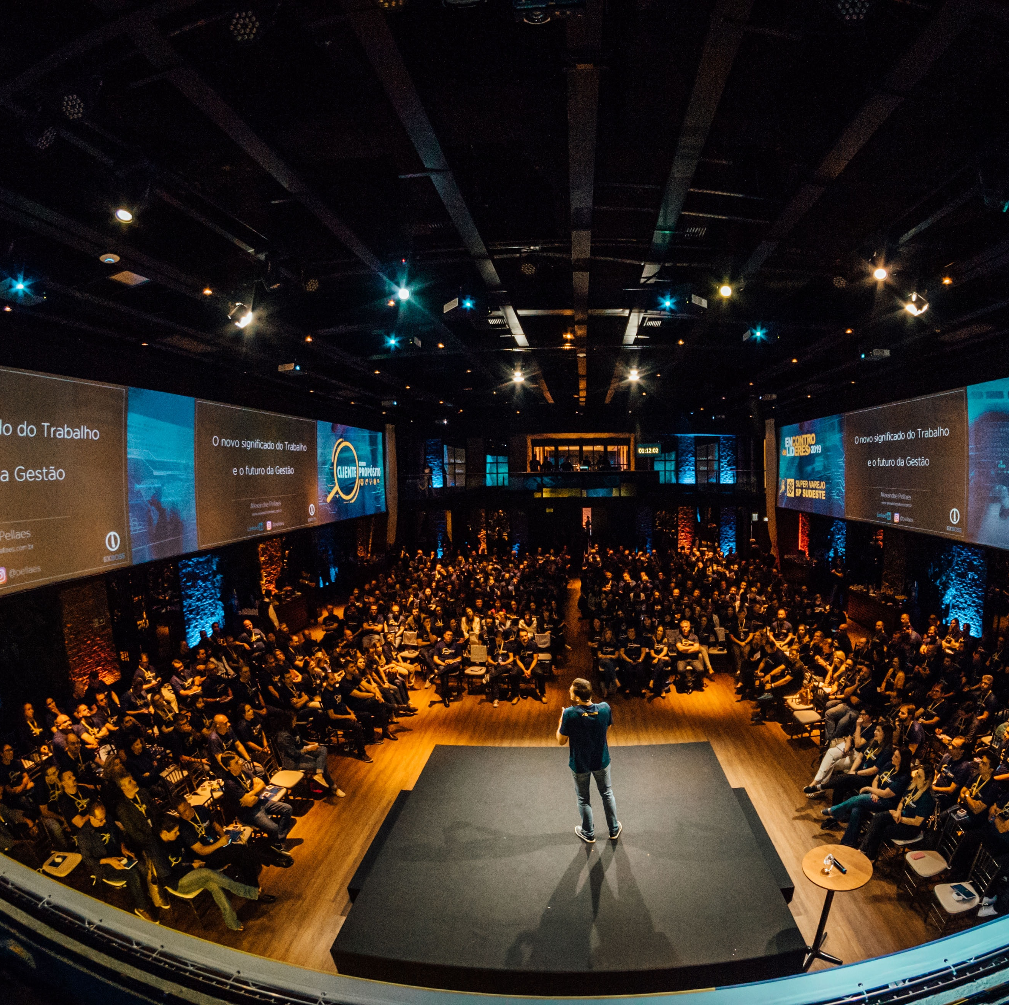
Thanks for attentions!
Q & A

